Slide 1
INTRODUCTION TO SOFTWARE ENGINEERING Lecture # 01
Engr. Rahemeen
Sr. Lecturer
Software Engineering Department

Slide 2
Introduction
Software is more than just a program code. A program is an executable code, which serves some computational purpose.
Software is considered to be a collection of executable programming code, associated libraries and documentations.
Software, when made for a specific requirement is called software product.
Engineering on the other hand, is all about developing products, using well-defined, scientific principles and methods

Slide 3
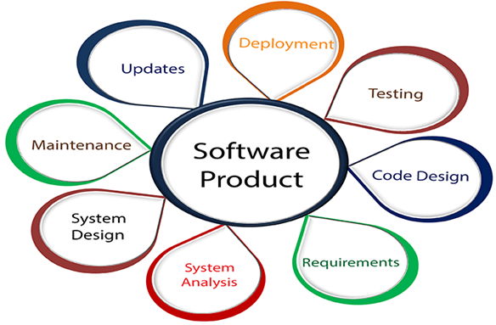

Slide 4
Need Of SE
The need of software engineering arises because of higher rate of change in user requirements and environment on which the software is working.
Scalability- If the software process were not based on scientific and engineering concepts, it would be easier to re-create new software than to scale an existing one.
Cost- As hardware industry has shown its skills and huge manufacturing has lower down the price of computer and electronic hardware. But the cost of software remains high if proper process is not adapted.
Dynamic Nature- The always growing and adapting nature of software hugely depends upon the environment in which the user works. If the nature of software is always changing, new enhancements need to be done in the existing one. This is where software engineering plays a good role.
Quality Management- Better process of software development provides better and quality software product.

Slide 5
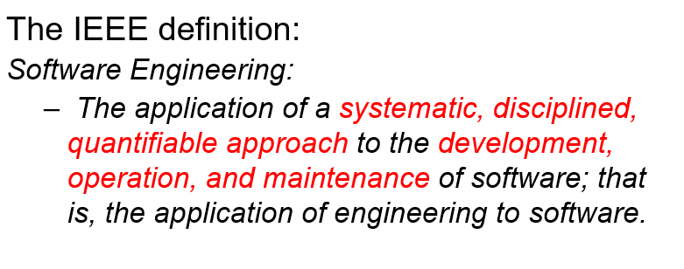
SE Define By IEEE

Slide 6
Attributes of Good SE
A software product can be judged by what it offers and how well it can be used.
This software must satisfy on the following grounds:
1. Operational
Software engineering on the operational level focuses on how the software interacts with the system, whether or not it is on a budget, the usability, the functionality, the dependability, and the security.
2. Transitional
This type focuses on how software will react when it is changed from one environment to another. It typically takes some scalability or flexibility in the development.
3. Maintenance
This aspect briefs about how well a software has the capabilities to maintain itself in the everchanging environment like Maintainability, flexibility, scalability etc.

Slide 7
Skills for SE
Software developers design software to help solve problems faced by real people. This requires a combination of both technical and soft skills. Generally speaking, most software engineers will need to have the following technical knowledge and skills:
Coding languages like Python, Java, C, C++, or Scala
Object-oriented programming
Database architecture
Agile and Scrum project management
Operating systems
Cloud computing
Version control
Design testing and debugging
Other beneficial soft skills for a software engineer may include:
Collaboration and communication
Multitasking
Continuous learning
Problem-solving
Agile project manage

Slide 8
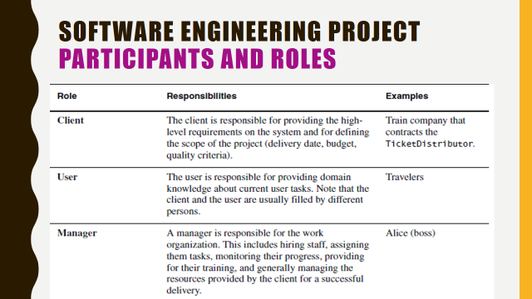
Participants & Role

Slide 9
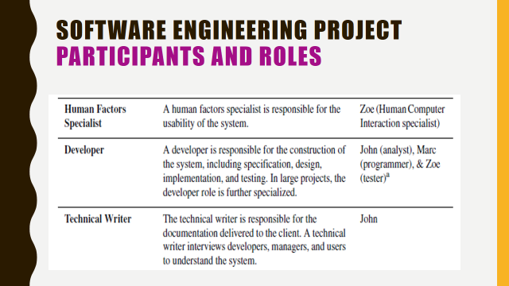

Slide 10
The Three-way Trade-off
Competing goals Every software project has a trade-off between functionality, cost, and time.
Extra functionality adds extra costs for testing development, maintenance, etc.

Slide 11
Software Applications
The software is used extensively in several domains including hospitals, banks, schools, defense, finance, stock markets, and so on. It can be categorized into different types:
1. System Software: System Software is necessary to manage computer resources and support the execution of application programs. Software like operating systems, compilers, editors and drivers, etc., come under this category. A computer cannot function without the presence of these. Operating systems are needed to link the machine-dependent needs of a program with the capabilities of the machine on which it runs. Compilers translate programs from high-level language to machine language.
2. Application Software: Application software is designed to fulfill the user’s requirement by interacting with the user directly. It could be classified into two major categories:- generic or customized. Generic Software is software that is open to all and behaves the same for all of its users. Its function is limited and not customized as per the user’s changing requirements. However, on the other hand, customized software is the software products designed per the client’s requirement, and are not available for all.
3. Networking & Web Applications Software: Networking Software provides the required support necessary for computers to interact with each other and with data storage facilities. Networking software is also used when software is running on a network of computers (such as the World Wide Web). It includes all network management software, server software, security and encryption software, and software to develop web-based applications like HTML, PHP, XML, etc.

Slide 12
4. Embedded Software: This type of software is embedded into the hardware normally in the Read-Only Memory (ROM) as a part of a large system and is used to support certain functionality under the control conditions. Examples are software used in instrumentation and control applications like washing machines, satellites, microwaves, etc.
5. Reservation Software: A Reservation system is primarily used to store and retrieve information and perform transactions related to air travel, car rental, hotels, or other activities. They also provide access to bus and railway reservations, although these are not always integrated with the main system. These are also used to relay computerized information for users in the hotel industry, making a reservation and ensuring that the hotel is not overbooked.
6. Business Software:This category of software is used to support business applications and is the most widely used category of software. Examples are software for inventory management, accounts, banking, hospitals, schools, stock markets, etc.
7. Entertainment Software: Education and Entertainment software provides a powerful tool for educational agencies, especially those that deal with educating young children. There is a wide range of entertainment software such as computer games, educational games, translation software, mapping software, etc.
8. Artificial Intelligence Software: Software like expert systems, decision support systems, pattern recognition software, artificial neural networks, etc. come under this category. They involve complex problems which are not affected by complex computations using non-numerical algorithms.
9. Scientific Software: Scientific and engineering software satisfies the needs of a scientific or engineering user to perform enterprise-specific tasks. Such software is written for specific applications using principles, techniques, and formulae particular to that field. Examples are software like MATLAB, AUTOCAD, PSPICE, ORCAD, etc.
10. Utility Software: The programs coming under this category perform specific tasks and are different from other software in terms of size, cost, and complexity. Examples are antivirus software, voice recognition software, compression programs, etc.

Slide 13
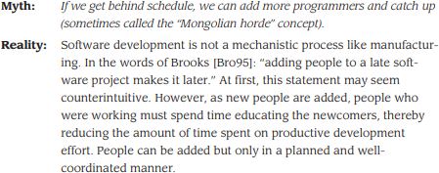
Software Myths

Slide 14


Slide 15
Software Tools
S/W eng tools provide automated or semi- automated support for the process and the methods.
When tools are integrated so that info. Created by one tool can be used by another,
a system for the support of S/W development called computer-aided software engineering is established.

Slide 16
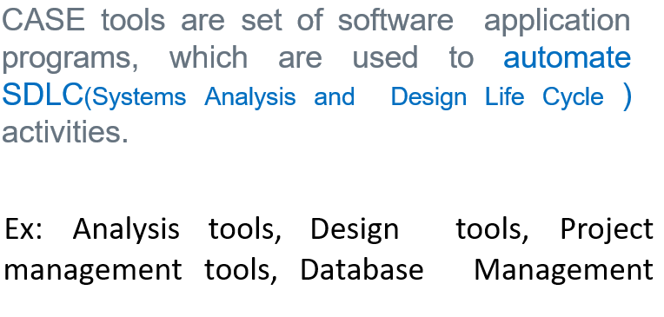
Case Tools

Slide 17
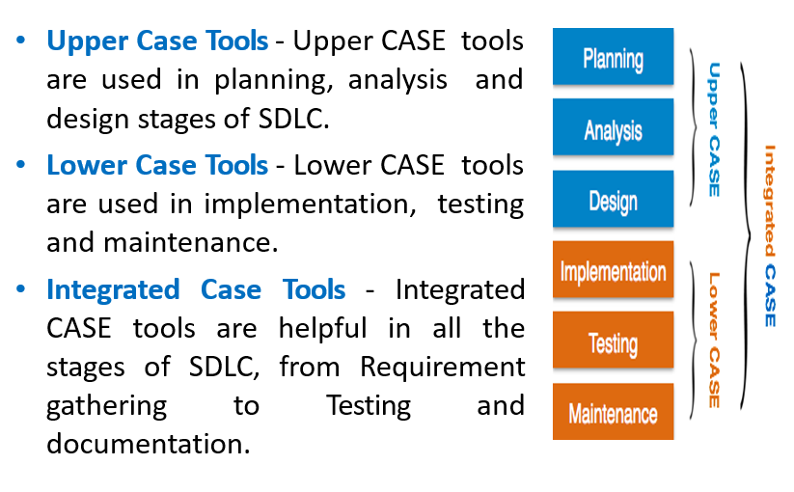
Components of CASE Tools

Slide 18
Summary
Software engineering is the combination of paperwork and Systematic solution of the addressed problem
Software is first designed then engineered .
Evolution and the maintenance is the essential and the last step of SE

Slide 19
Q/A

